Slide 1
!
Getting ready for spring flooding
Proposed Plan of Action for Old Ottawa East
Pauline Lynch-Stewart & Peter Croal
With assistance from Mitchell Beer and Carol Alette
Photo credit: Ross Dunn

Slide 2
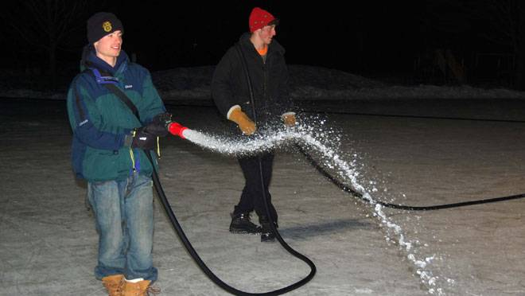
Yes, this is flooding
Photo credit: John Dance

Slide 3
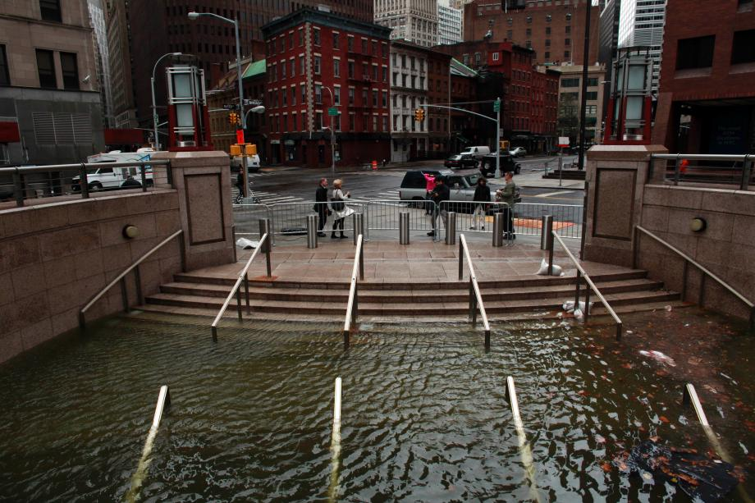
And so is this… It will never happen in New York
www.slate.com

Slide 4
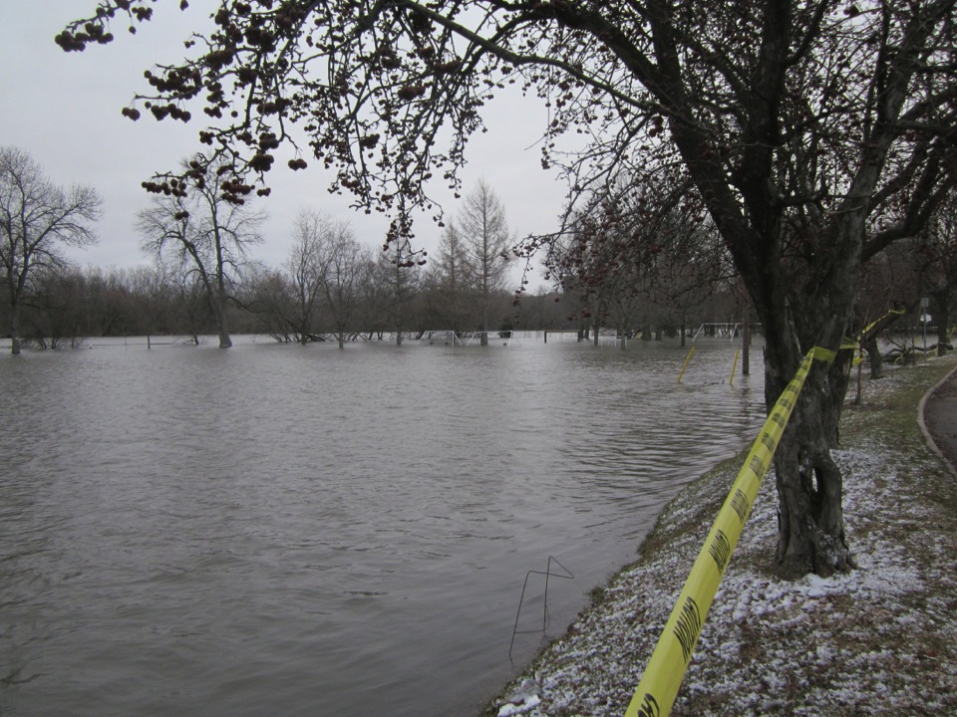
April 7, 2014
Photo credit: John Dance

Slide 5
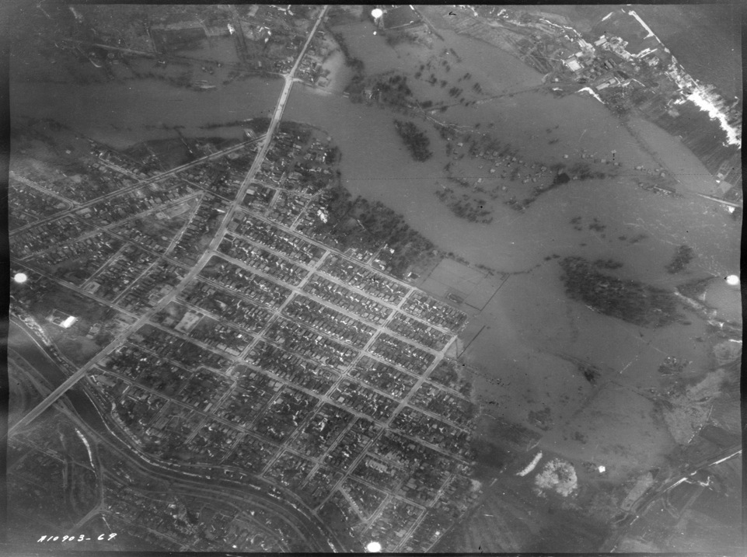
Billings Bridge
April 12, 1947
Would you live here??
Source: OSCA / National Air Photo Library
Notes:
“The Years of the Great Floods” Original Published in the April 2008 OSCAR.
http://www.oldottawasouth.ca/index.php/oshp-articles/oshp-articles-list/1465-the-years-of-the-great-floods
he accompanying aerial photo of April 12, 1947 from the National Air Photo Library shows perhaps one of the worst floods of the past century in Old Ottawa South and Billings Bridge. The flood waters followed the land contour and filled in all the low spots extending to the end of Glen Ave and covering what is now Bronson Ave into the Carleton University property. On the south side of the river a cluster of houses known as Nordic Circle where there is now an NCC park were completely flooded. The entrance to the Merkley brick yard, near the present R.A. Centre, was also awash, as was the site of the future Billings Bridge Plaza.
Bob Simpson & Fred Cooper, Tennis Court Parking Lot During Flood, 1959 - credit Courtesy of Bob Simpson
The year 1959 saw another major flood as is attested to by the family snapshot showing local boys Bob Simpson and Fred Cooper in the Ottawa Tennis Club parking lot. No doubt fun for horsing around in your gumboots.
Major flooding occurred again in 1976 with high water on March 27, as was reported in the April 1976 issue of OSCAR (vol. 3 no. 4). The waters covered Marco Lane, the south end of Leonard Ave, the west end of Cameron Ave and Rideau River Lane. It was particularly frustrating for area residents as the Rideau Valley Conservation Authority (RVCA) was scheduled to have completed work on a flood control dyke at the end of 1975 that would have saved most from the effects of the flooding but it was still unfinished come the spring freshet. According to RVCA historical data, 1976 saw the all time high peak flow rate of the spring runoff, but overall the flooding was possibly less severe than 1947.
Long time local resident Harry Thomson recalls 1976 was a very bad year. Across from his house on Rideau River Drive on the bank of the Rideau River he has mounted a measure stick to track the annual flooding. He recorded a water level of 5’ 11 1/2” at peak that year.
On the east side of the neighbourhood the Lexington Apts on Riverdale were hard hit in 1976. This area had to wait until October 13, 1984 for the official opening of the Windsor Park Flood Control Dyke and pumping station, located in what is now known as Linda Thom Park. With no flood dyke to protect Belmont and Fentiman Aves, the end of those streets was again submerged under water in the late 1990s.
While it may be the case for the stock market that "past performance is not a reliable indicator of future results," we can be fairly certain that if not this year some time soon the Rideau will once again surprise us with her spring waters.

Slide 6
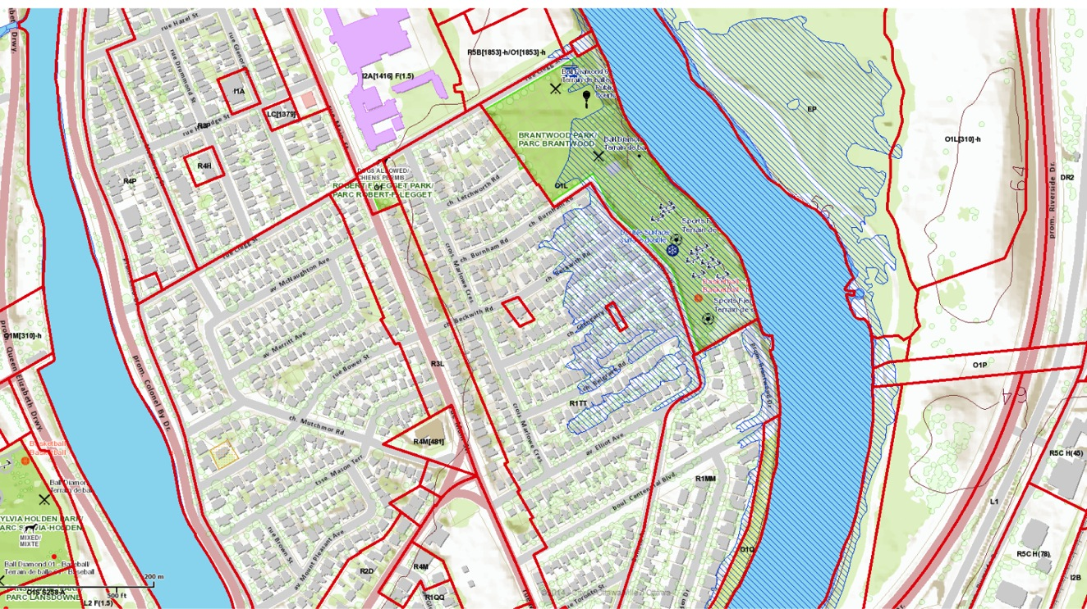
Source: ottawa.ca

Slide 7
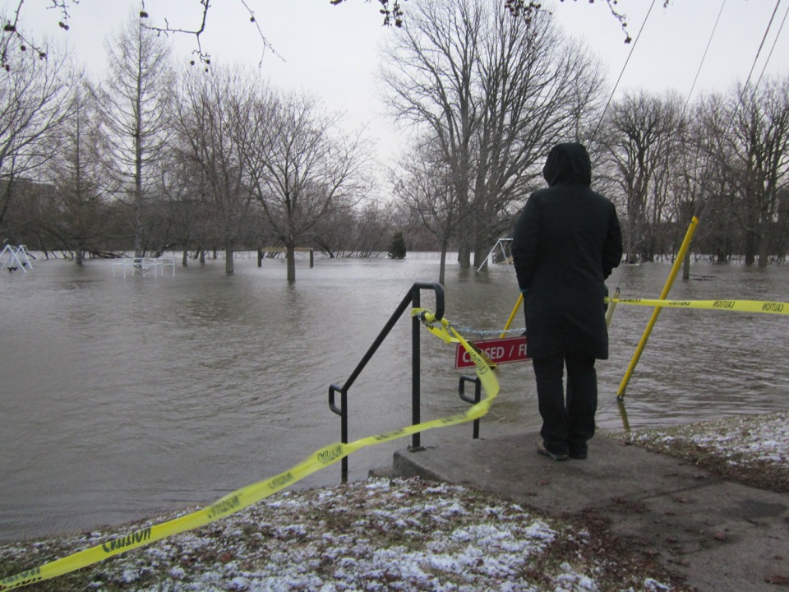
April 7, 2014
What about 2015 and on??
Photo credit: John Dance

Slide 8
Rideau Valley Conservation Authority
Flood Warning Update Statement
Forecast Rain Expected to Cause Extensive Flooding
April 12, 2014 -- Rainfall of 40 millimetres (mm) or more, starting late Saturday evening through Monday, is expected to cause existing high flows to increase significantly.
…expecting flows on the Rideau River below Hog’s Back Falls could reach 570 cubic metres per second (cms) by late afternoon or early evening on Sunday and 610 cms by Monday night.
Such flows would far exceed the flow of 497 cms reached in 2008 and the highest flow recorded to date on the Lower Rideau, which occurred in 1976 at 597 cms. (The period of record extends from 1933 to present.)

Slide 9
Rideau Valley Conservation Authority
Flood Warning Update Statement
Forecast Rain Expected to Cause Extensive Flooding (cont’d)
…Areas that can be expected to be affected by out-of-bank flow spilling across local streets and into residential areas include:
    New Edinburgh in the vicinity of Stanley Avenue
    Brantwood Park at Onslow Crescent
    Old Ottawa South (Rideau River Drive, Warrington Drive, Harvard, and Raleigh)
    Communities on the Long Reach upstream of Manotick…

Slide 10
The problem
Many OOE residents were unaware of flood warnings
Once made aware, most people did not know when or how to respond; others unable to respond
Apparently no leadership or system in place at the community level to:
  Communicate with authorities about how they could help
  Communicate information from authorities to vulnerable residents
  Coordinate neighbourhood mitigation efforts
  Connect residents in the flood zone with other folks willing to help

Slide 11
What went right
Information shared with neighbours in ad hoc way
RVCA (Patrick Larson) advised us on response
City of Ottawa 311 provided information on sandbags
OOECAG used their mailing list to inform residents
Residents ready and willing to mitigate flood damage
Community church offered help

Slide 12
This project
Goal
  The community of OOE is better prepared to safeguard our homes and families in the face of Rideau River flooding
Objectives 2014/2015
  OOE residents get the information they need when they need it
  We know how to protect homes and families
  We have a way to rally residents and others for community-wide actions
  All parties are working together to do the best we can to protect our properties and families
    Focus on preparing for and mitigating flooding!

Slide 13
Tonight’s Agenda
7:15 p.m. Spring flooding in Ottawa: How your municipality prepares and responds
Questions for City of Ottawa
7:50 p.m. Flooding in Old Ottawa East: History and future expectations
Questions for RVCA
8:30 p.m. Proposed emergency communications network: A pilot project for Brantwood Park
Discussion on proposal
9:00 p.m. Wrap-up and next steps

Slide 14
How can we better answer basic questions?
How do I find out if the Rideau is expected to flood?
Is there someone I can contact for more details about my neighbourhood?
  How high could the water get?
  Where will the water come from?
When and how do I prepare my home?
Who can help? How do I contact them?
Notes:
Where can I get information on Rideau water levels?
How do I find out if the Rideau is expected to flood? Who will inform me? When? What is my responsibility in ensuring this communication?
Is there someone in the neighbourhood I can contact for more details? (flood marshals? flood captains?)
Where will the water come from? overland? ground water? (info for sump pumps and backwater valves)
How high could the water get? What does this mean for the neighbourhood? What would those levels look like on my street?
How do I prepare my home? What shall I do and when in terms of moving furniture? pets? sandbagging?
Is there someone to help me? What will happen if I am unable to prepare my own home due to absence, disability, age, etc.?

Slide 15
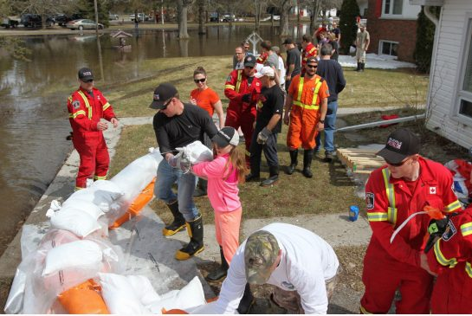
Recommendations
Communications
Public awareness
Resident preparation
Leadership
April 12, 2014 – Foxboro, ON. Photo: The Star

Slide 16
1. Communications
Establish a community-based communications network (e.g. email list, Facebook)
    In advance
    Improve accessibility to existing information
    During spring freshet
    Deliver updates from authorities to OOE residents
    Coordinate action to mitigate flooding

Slide 17
2. Public awareness
City of Ottawa Are you ready? workshops presented regularly for OOE residents
  The program utilizes a grassroots network to deliver emergency preparedness workshops
  Objectives are to:
    Educate the community on emergency planning
    Raise awareness on how to prepare for an emergency
    Increase individual self-reliance in times of emergency

Slide 18
3. Resident preparation
Residents fulfil their own responsibilities to be ready for spring flooding
  Attend Are you ready? workshop and implement recommendations
    Prepare to follow the advice of the authorities
  Provide your contact details for real-time communications during a flooding event

Slide 19
4. Leadership
All these efforts have continuing support of OOECA
  profile
  guidance
  long-term sustainability
Efforts are implemented by community volunteers, but backed by strong leadership of OOECA
  E.g. OOECA President appoints resident(s) to coordinate network, workshops

Slide 20
Plan of Action: 2015
Network implemented
City of Ottawa “Are you ready?”
Draft Plan for 2016 presented to community
Community
meeting
Plan implemented: network put in place
Public awareness / support built
Pilot network in place
Results assessed /
Draft Plan for 2016
Proposal to OOECA
JAN
OCT
NOV
MAR
APR
MAY
JUN
JUL
AUG
SEP
FEB
DEC
JAN
FEB
Phase 1: Development and consultation
Phase 2: Pilot delivery and testing
Phase 3: Assessment, revision, consultation
Phase 4: Implementation
Phase 5: Community awareness building

Slide 21
Your feedback
What do you think about the proposal?
  Questions? Anything to add? What would you do differently?
Are you interested in participating?
  Implementing the idea for 2015
  Revising / expanding the network for 2016

Slide 22
Next steps
Investigate issue of liability for OOECA
Determine best platform for communications network?
  Near term
  Long term
Build the communications network
Collect and integrate contact details for residents
Establish lines of communication with authorities
Link the community with existing information
Host the City of Ottawa “Are you ready?” program for OOECA

Slide 23
!
Getting ready for spring flooding
Proposed Plan of Action for Old Ottawa East
THANK YOU
Photo credit: Ross Dunn

